Slide 1
Mental Health in AUStralia
Exploratory ANALYSIS of DATA from the 2021 ABS CENSUS
Dale Munroe
Periyanayagi Parkavi Jayachandran Vasantha
Maria Buenaventura
Matthew Ford
August 2022

Slide 2

Introduction
2021 ABS Census with > 96% response rate
Questions asked in the Census included:
Permanent mental health conditions
Dwelling types
Number of bedrooms
Household composition
Data released by postcode

Slide 3
What can the 2021 ABS Census tell us about factors that may correlate with a high prevalence of mental health conditions?

Slide 4
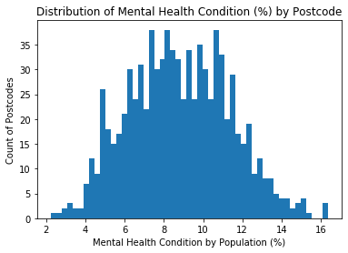
Preparing the Data Set
Data analysed by postcode, not by household
Postcodes with < 10,000 people removed
Normal distribution of dataset confirmed
Latitude / Longitude data taken from AusPost

Slide 5
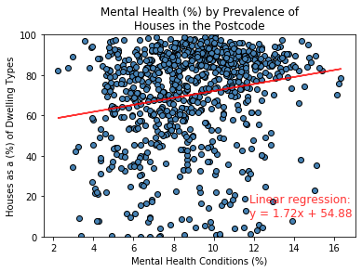
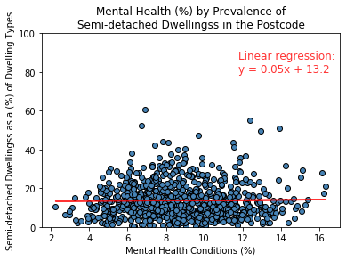
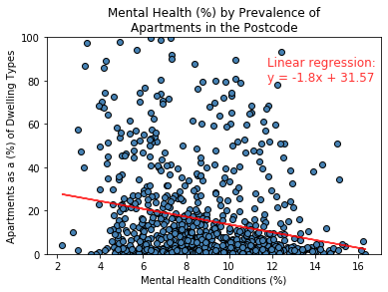
Mental Health vs Dwelling type
No or weak correlation found between mental health and dwelling type

Slide 6
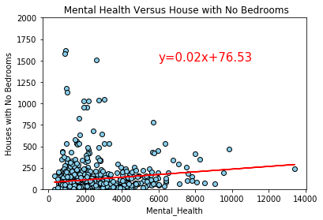
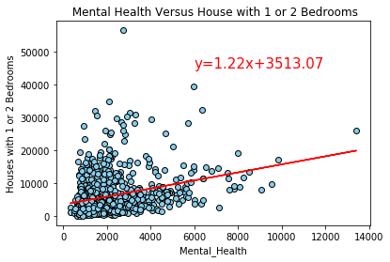
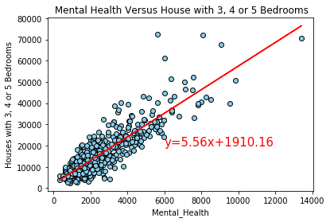
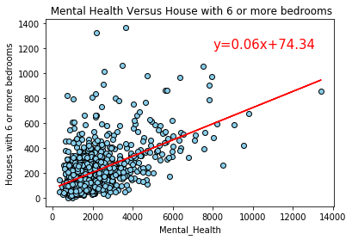
Mental Health vs Number of Bedrooms in A DWelLing
Low correlation found between mental health and small dwellings
Strong correlation found between mental health and medium sized dwellings
Moderate correlation found between mental health and large dwellings

Slide 7
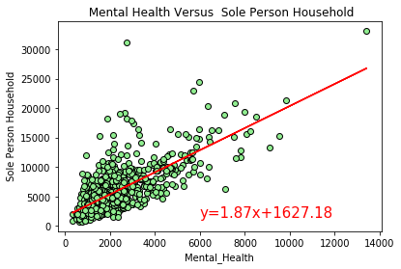
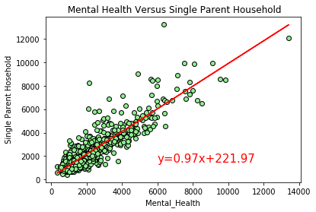
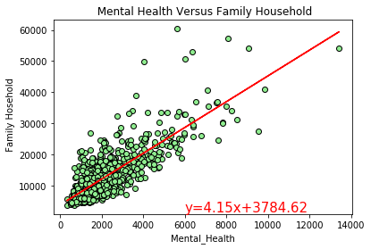
Mental Health vs household composition
Strong correlation found between mental health and single parent household.
Moderate correlation found between mental health and family household or sole person household.

Slide 8
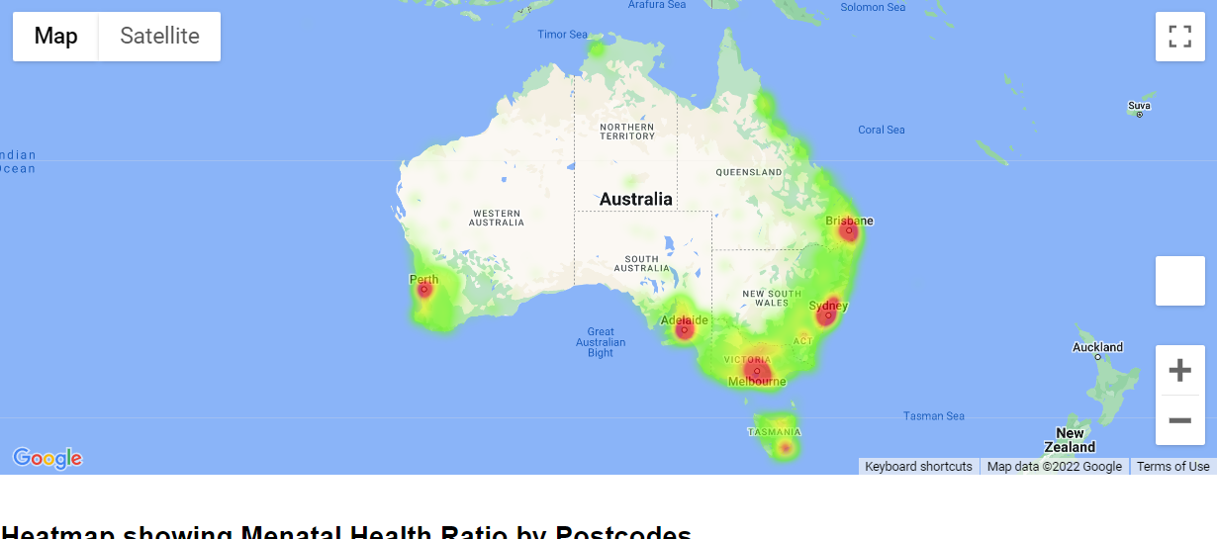
Mental Health by region
Postcodes with most mental health conditions are predominantly in urban centres
Northern Territory has lowest % of mental health conditions by population
Heatmap of postcodes by % of population with mental health conditions

Slide 9
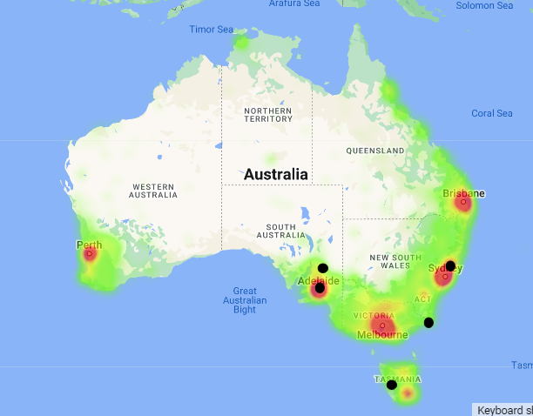
Mental Health by region
Of those postcodes with >20% prevalence of mental health, only one is within urban centre
Heatmap of postcodes by % of population with mental health conditions
Black dots represent mental health conditions >20%

Slide 10
Repository can be accessed at
https://github.com/ricamaria/Project-1
Questions?

